Slide 1
at
Welcome to
the Library
Terrace Manor
Elementary School
Jennifer Adams
EDIT 6263
December 2, 2010
School Library Orientation

Slide 2
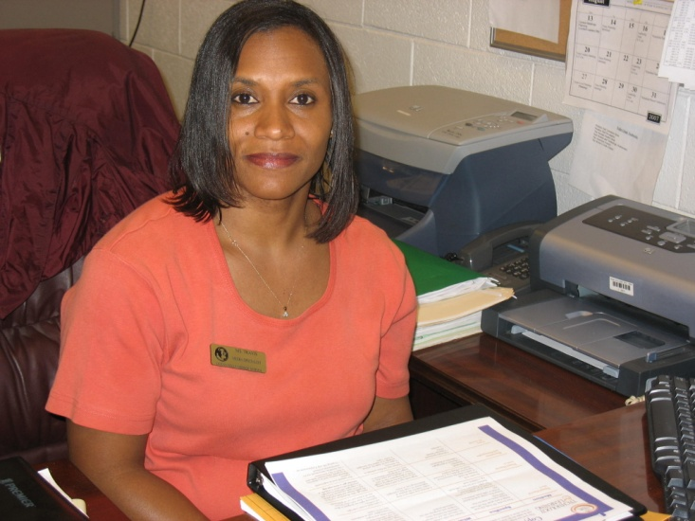
Important Information
Media Specialist
LaTonya Travis
Hours of Operations
8:15a.m. till 4:00p.m.
Media Assistant
Ms. Lanham

Slide 3
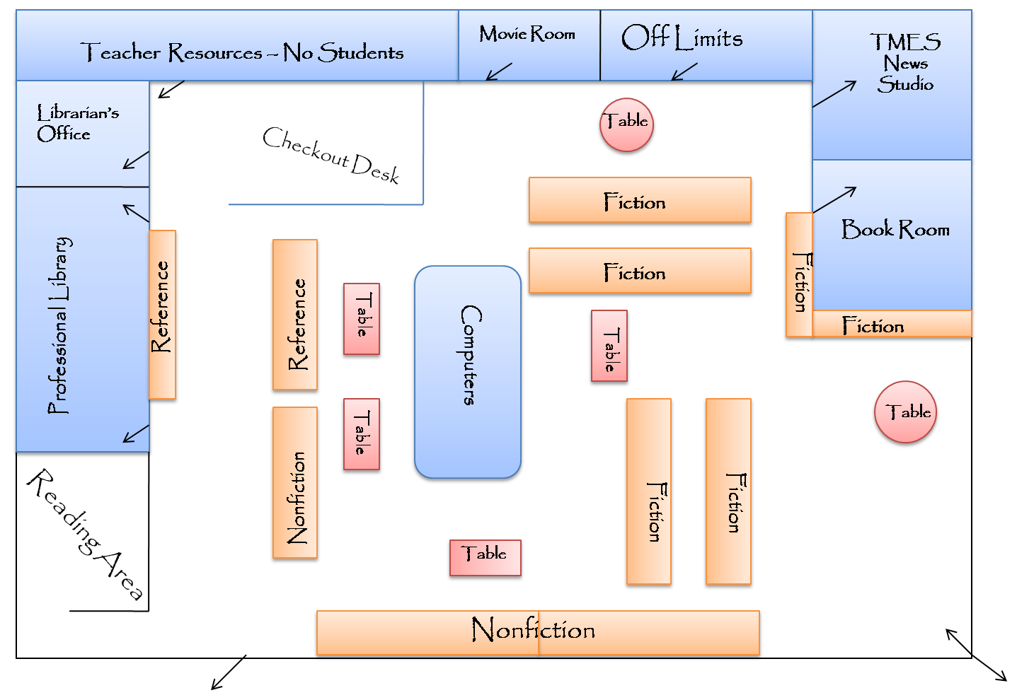
Come on in and join us in the Library. To begin your tour click on any section.
Just click on the arrows to return to this page.

Slide 4
Thanks for Visiting.
You come back and see us now!!!

Slide 5
Bibliography
Image retrieved from Google images on December 2, 2010. Which in turn sent me to
http://www.odcpl.com/
Image retrieved from Google Images on December 2, 2010. Website Google retrieved from was a dead link. .

Slide 6
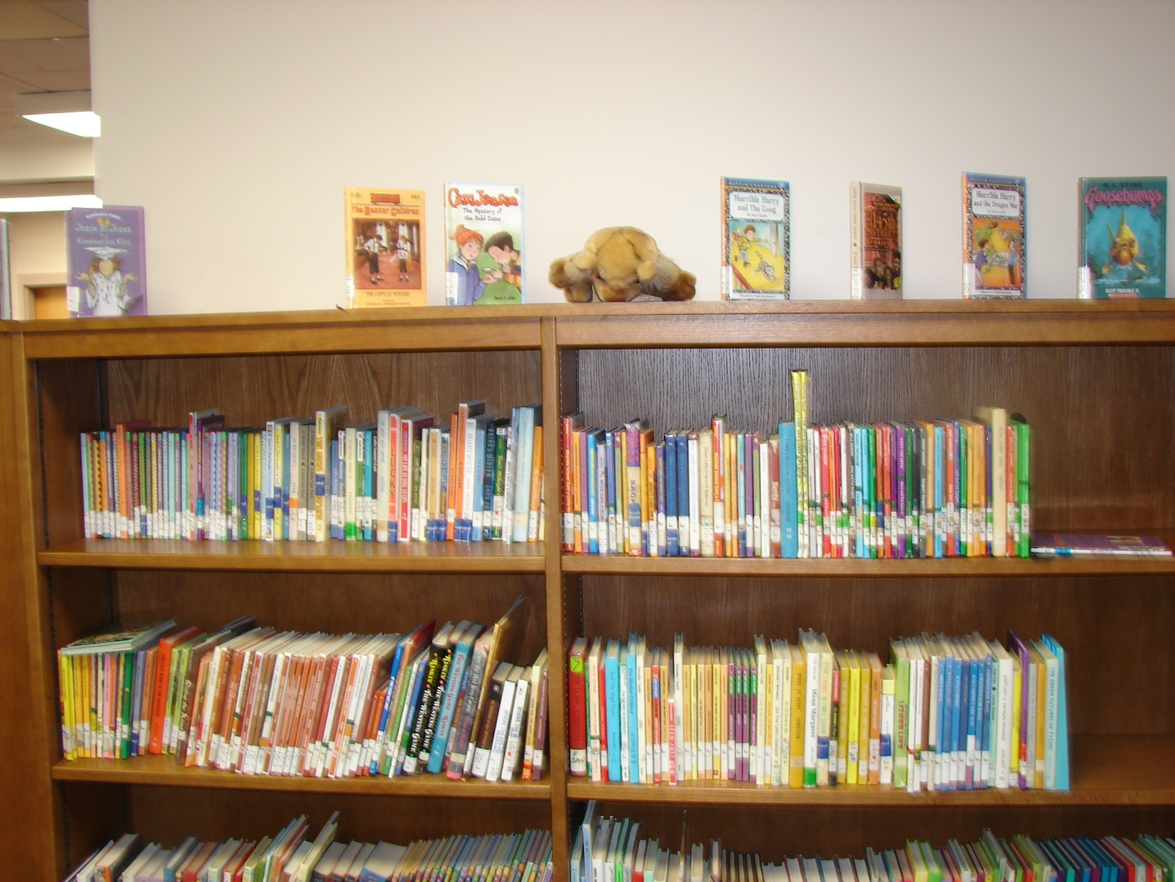
Come visit our Fiction section and see where a book can take you !!!

Slide 7
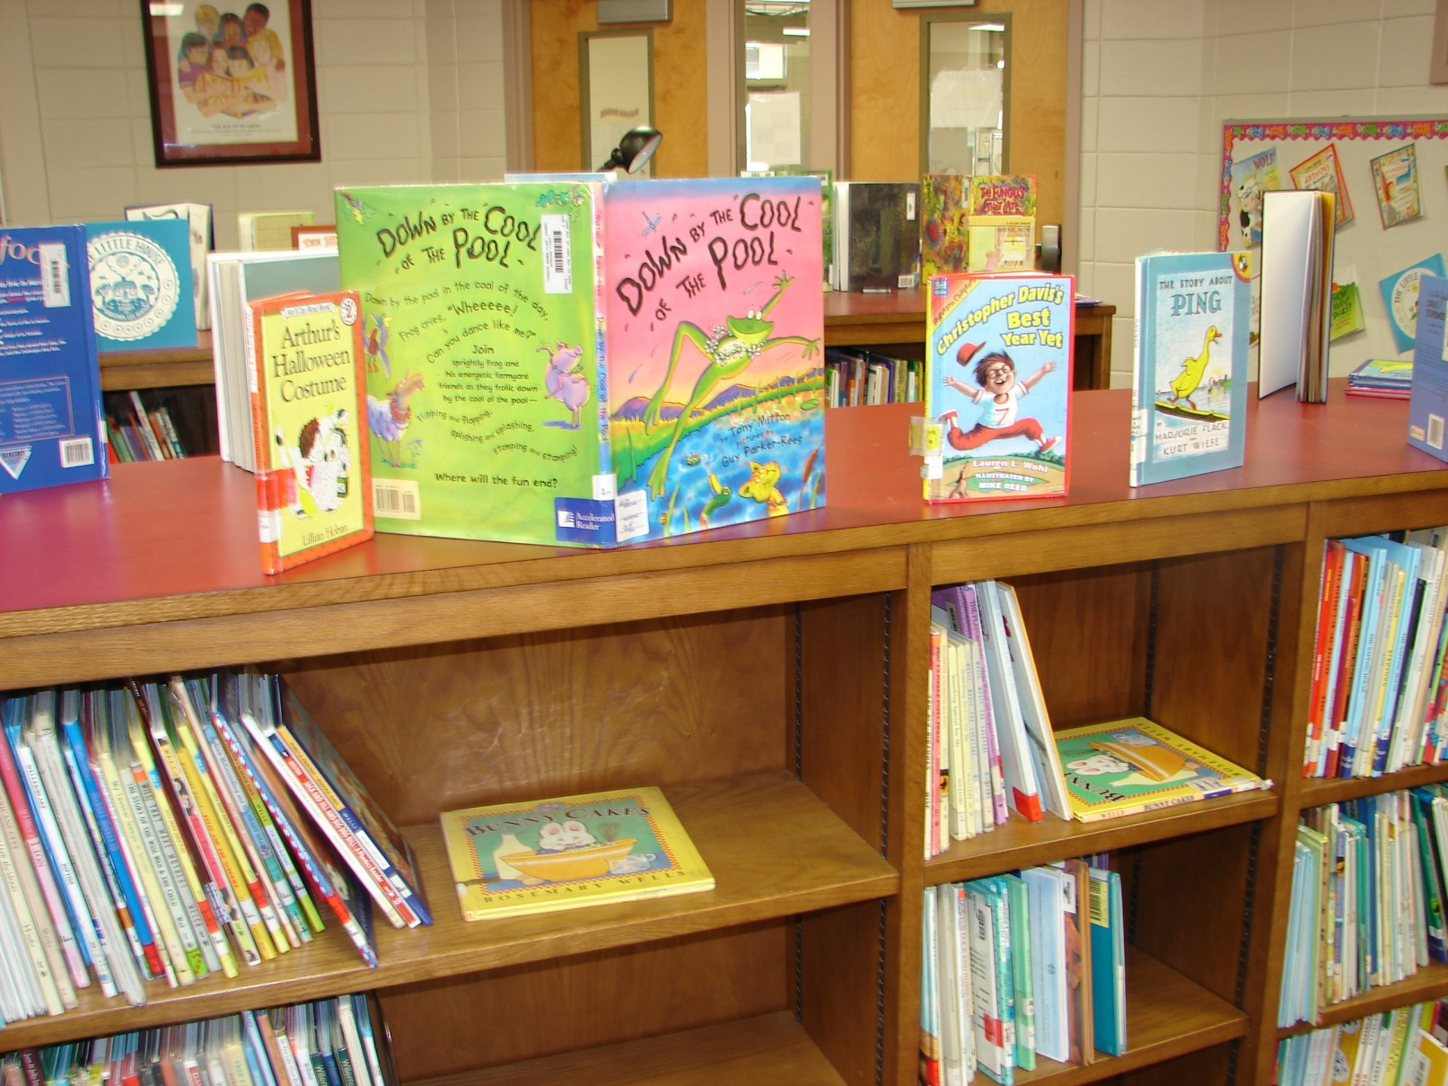
If you are sweatin’ some classes
come cool off with us.

Slide 8
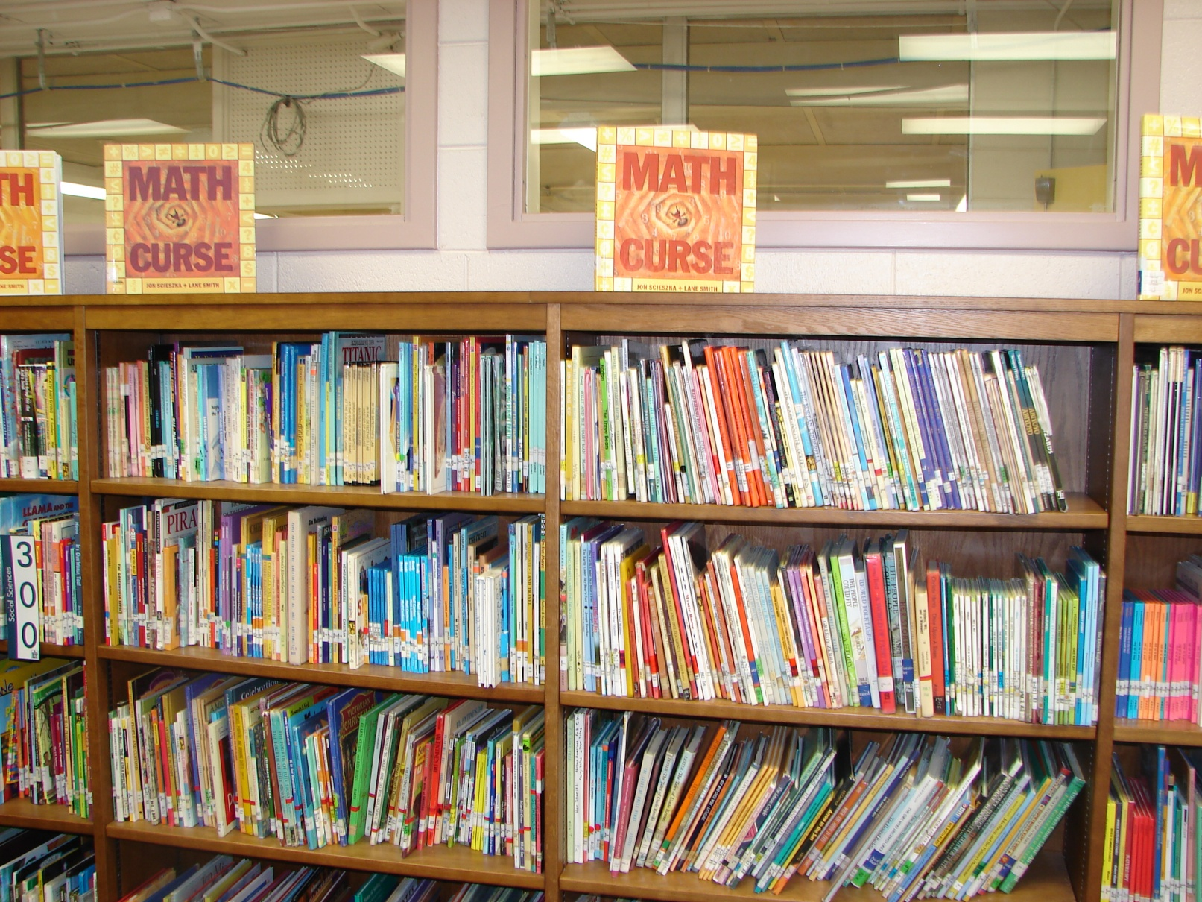
Is Math a curse to you?
Come check out some other famous
people who might feel that same way.

Slide 9
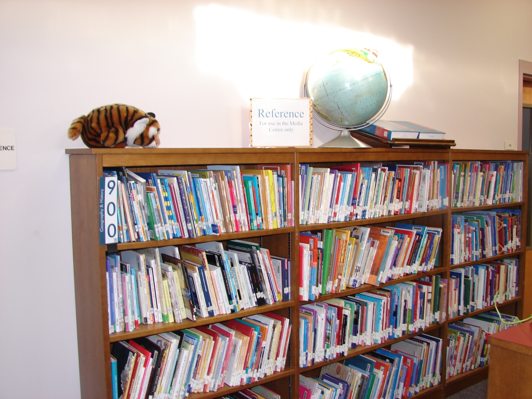
Our reference section is here for your
use.
But, it cannot leave the library.

Slide 10
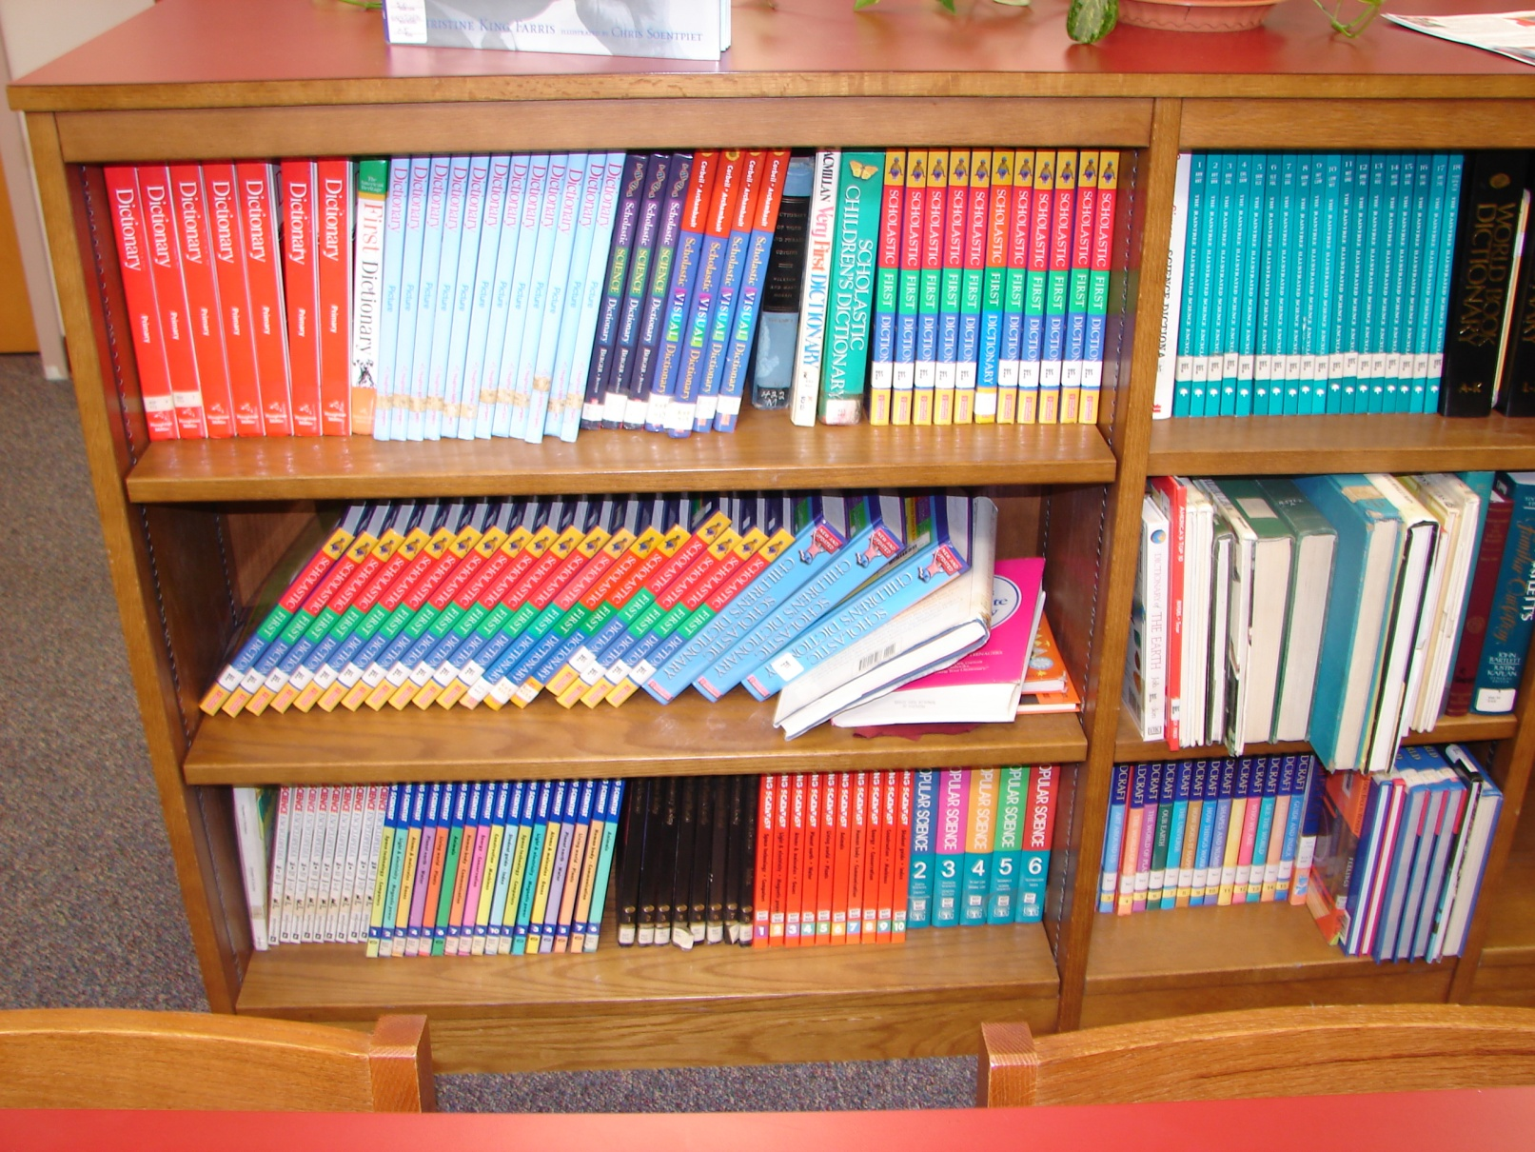
Use the general and subject encyclopedia
to search for answers.

Slide 11
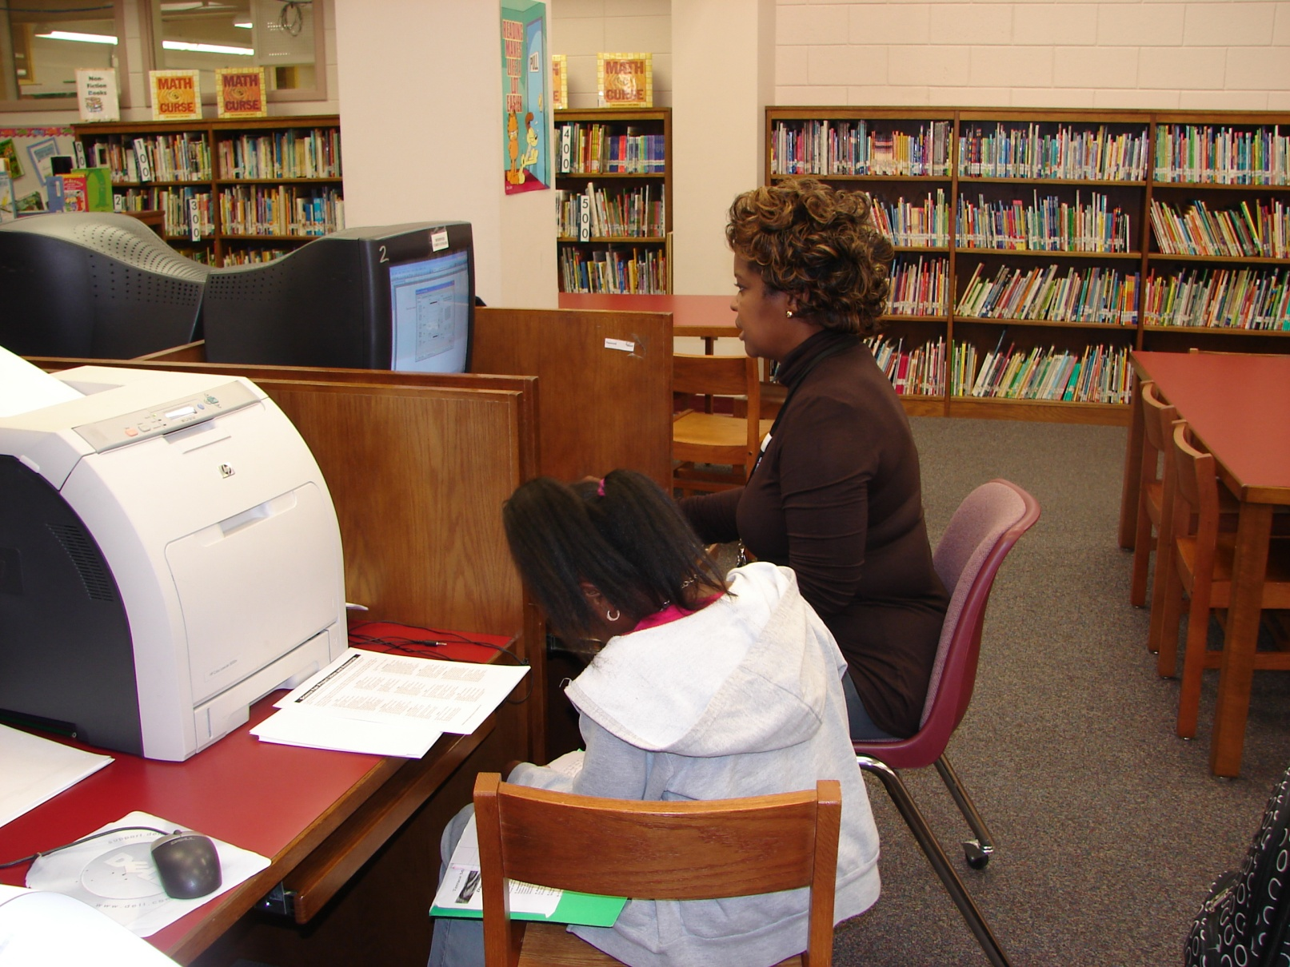
Use the computers to look
for a book in our library or
Research online.

Slide 12
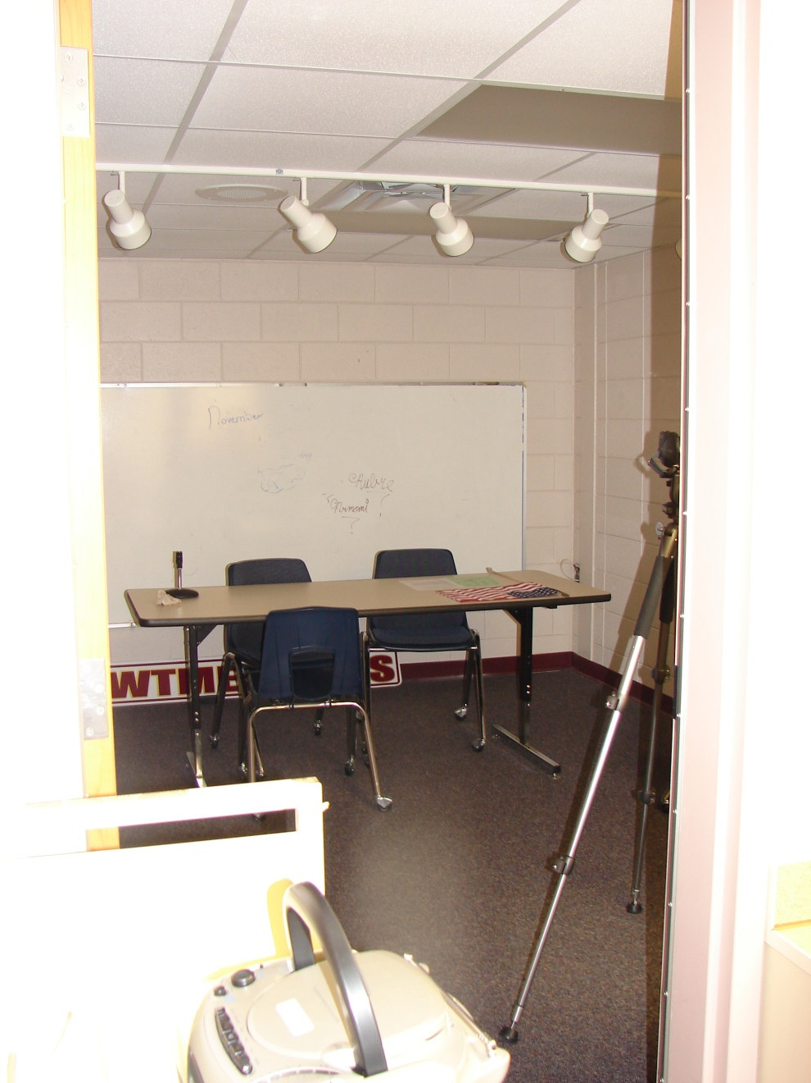
Check out
The
TMES News
Room

Slide 13
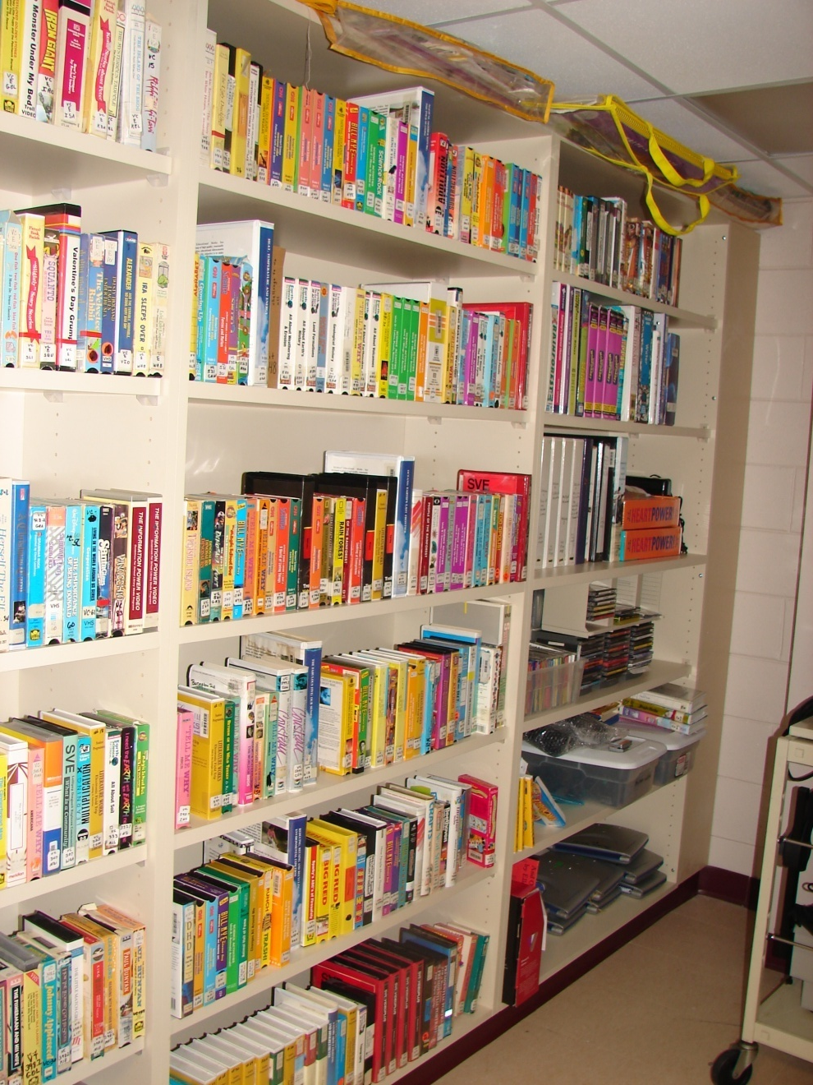
Explore the world
of videos at your
teacher’s fingertips.

Slide 14
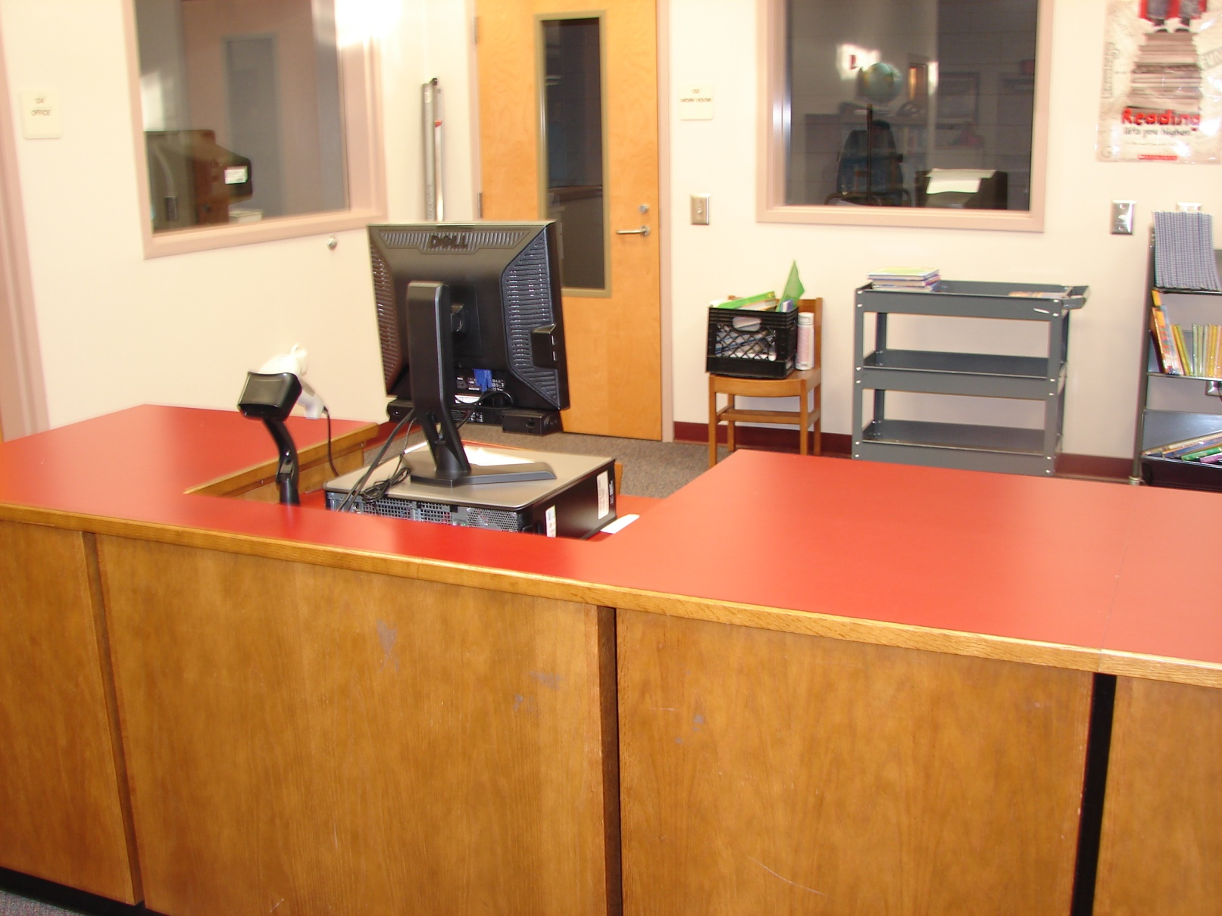
Check out all your latest finds at the check-out desk.

Slide 15
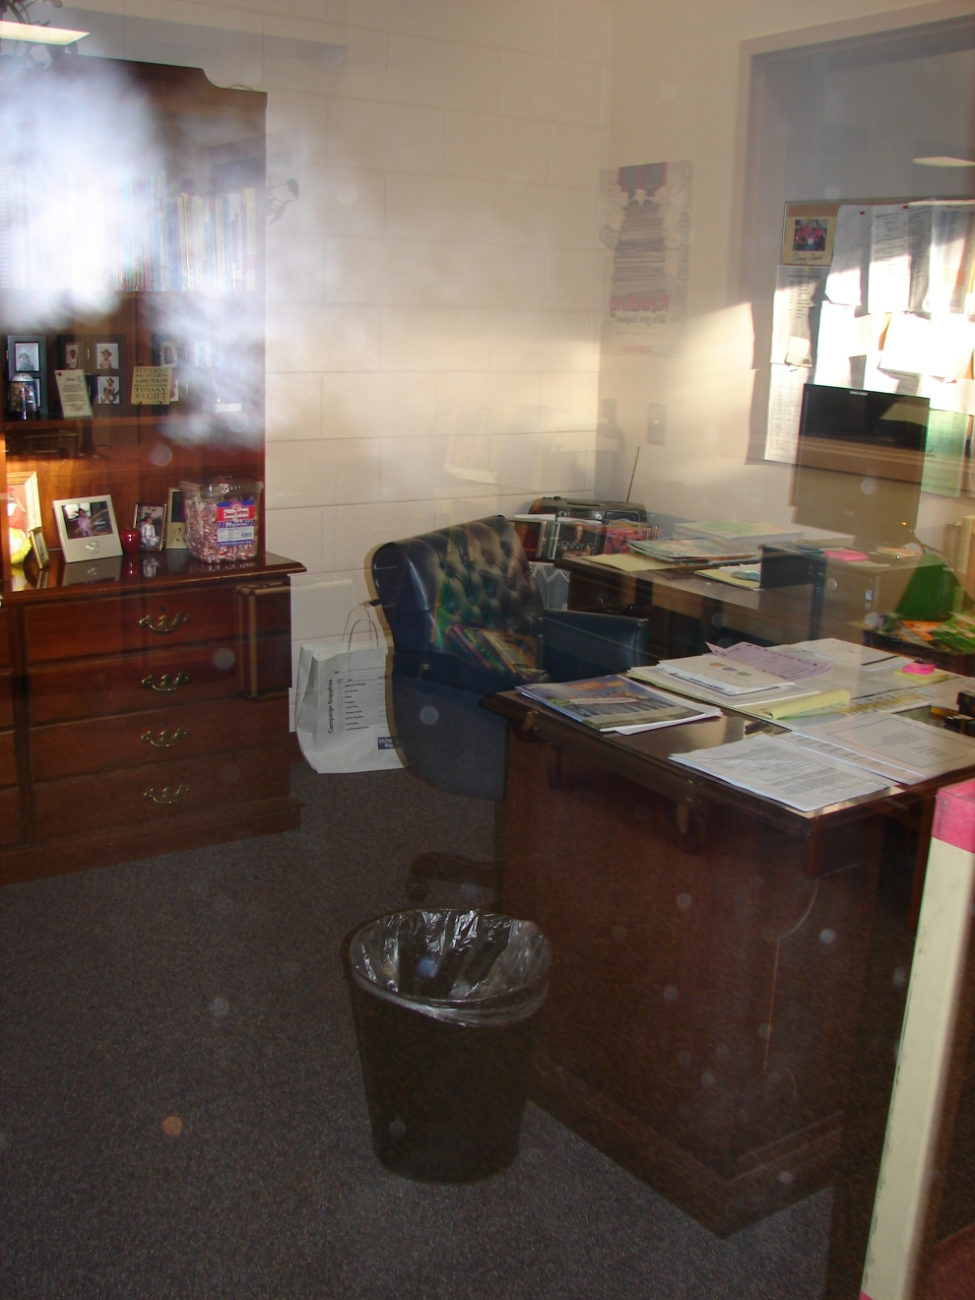
When not at the
check-out desk,
this is where you
will find Mrs. Travis.

Slide 16
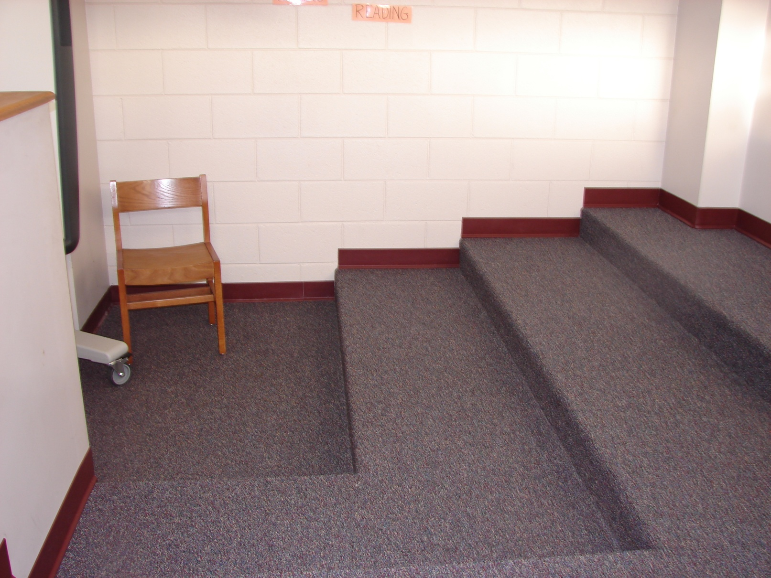
For the younger grades, your teacher
can sign up your class for story time.

